Slide 1
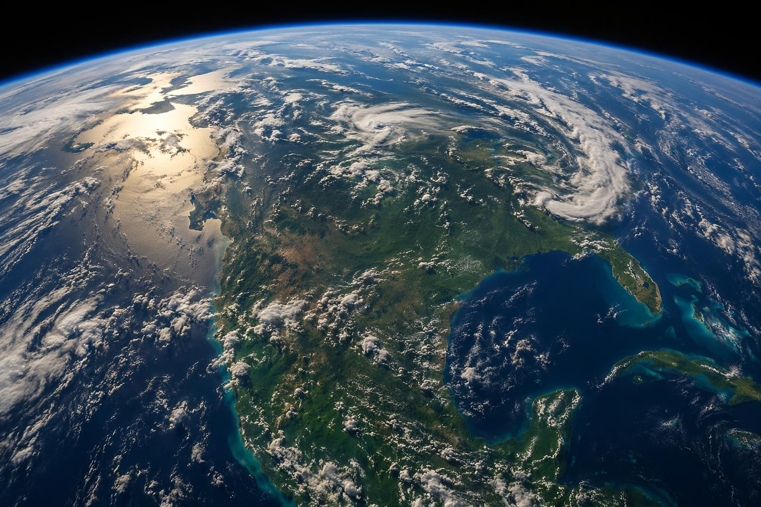
Climate Change
The Science Behind Our Warming World
A Presentation for High School Students | 2026
Notes:
Welcome everyone! Today we're going to explore the science behind climate change — what's causing it, what the evidence tells us, and what we can do about it.
Climate change isn't just a topic in the news — it's one of the defining challenges of your generation. By the end of this presentation, you'll understand the science well enough to explain it to anyone.
Let's start with the basics.

Slide 2
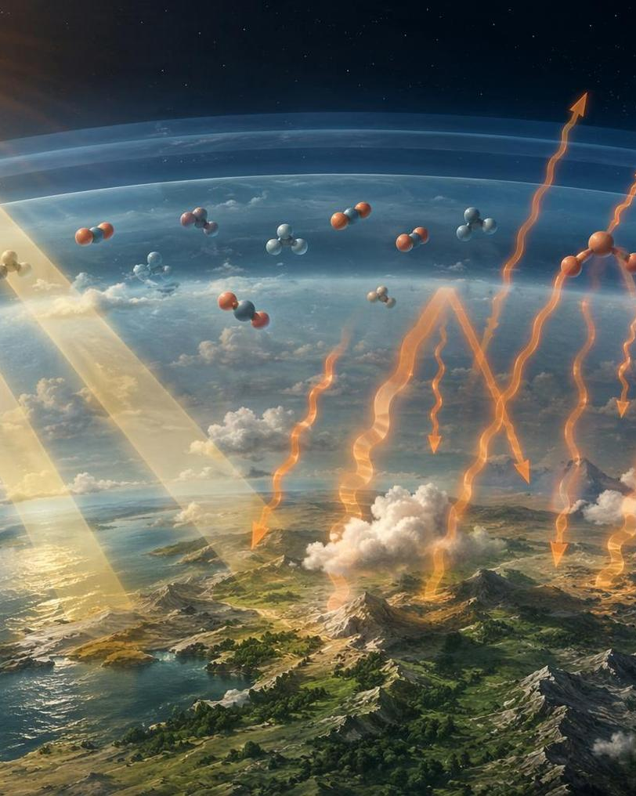
The Greenhouse Effect
Sunlight passes through the atmosphere and warms Earth's surface
Earth radiates heat back as infrared radiation
Greenhouse gases (CO₂, methane, water vapor) trap this heat
Without it, Earth would be −18°C — too cold for life
Human activity has intensified this process, trapping more heat than ever
Think of greenhouse gases as a blanket around Earth
Notes:
The greenhouse effect is actually a natural and essential process. Without it, Earth's average temperature would be around minus 18 degrees Celsius — that's 0°F. Way too cold for life as we know it.
Here's how it works: sunlight passes through the atmosphere and warms the Earth's surface. The surface then radiates that heat back as infrared radiation. Greenhouse gases — carbon dioxide, methane, water vapor, and others — absorb some of that infrared energy and re-emit it in all directions, including back toward the surface. That's the 'blanket' effect.
The problem isn't the greenhouse effect itself — it's that human activities, especially burning fossil fuels, have dramatically increased the concentration of these gases. More gas means a thicker blanket, which means more trapped heat.
Think of it like adding extra blankets on a warm night — at some point, you start overheating.

Slide 3
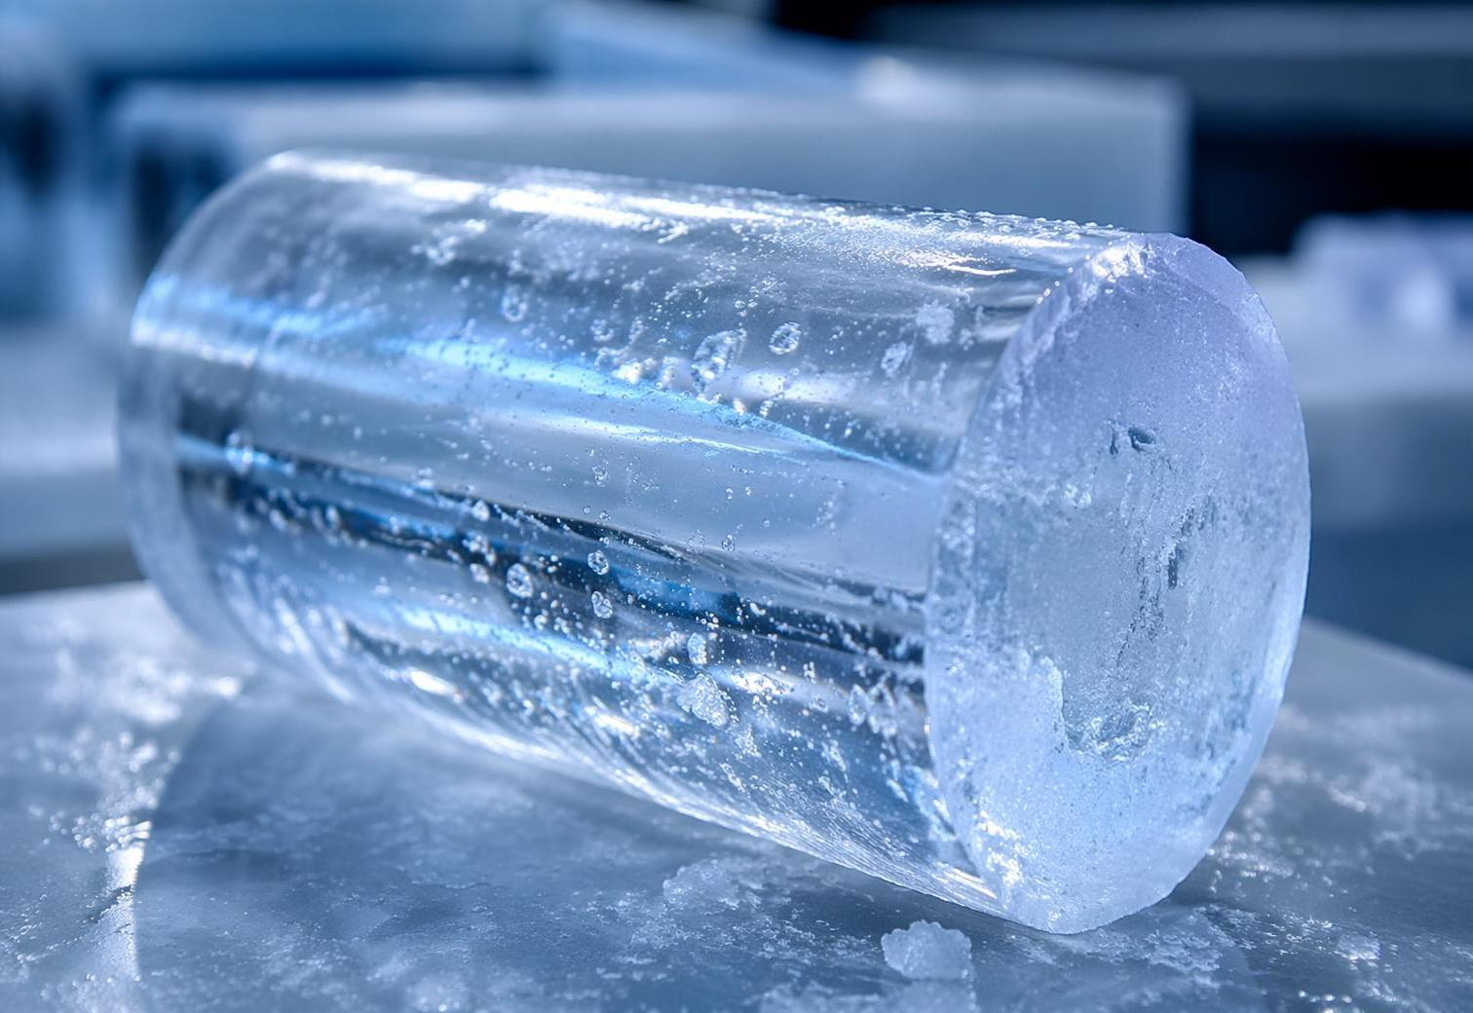
The Evidence: CO₂ Through Time
429 ppm current CO₂ level (Feb 2026)
50%+ increase since the start of industrialization
Data: NOAA Mauna Loa Observatory | Ice cores extend record back 800,000 years
Notes:
So how do we know CO2 levels are rising? Two key sources of evidence.
First, direct measurements. Since 1958, scientists at the Mauna Loa Observatory in Hawaii have been continuously measuring atmospheric CO2. That's the line chart you see here — a steady, accelerating climb from about 317 parts per million to 429 ppm as of February 2026.
Second, ice cores. Scientists drill deep into Antarctic ice sheets and extract cylinders of ancient ice. Tiny air bubbles trapped in these cores preserve samples of Earth's atmosphere going back 800,000 years. These show that CO2 levels naturally fluctuated between about 180 and 280 ppm during ice ages and warm periods. Today's 429 ppm is more than 50% higher than anything in that 800,000-year record.
That 50% increase happened in just about 150 years — a blink of an eye in geological time.

Slide 4
A Decade of Record Heat
2015–2025: The hottest 11 consecutive years on record
+1.44°C in 2025
770M felt record warmth
2°C over land in 2025
Source: WMO State of the Global Climate 2025 | Berkeley Earth
Notes:
Now let's look at what all that extra CO2 is doing to temperatures.
According to the World Meteorological Organization and Berkeley Earth, 2015 through 2025 are the eleven hottest years ever recorded. That's not a coincidence — it's a trend driven by increasing greenhouse gas concentrations.
2024 was the hottest year on record at 1.55°C above pre-industrial levels. 2025 came in at 1.44°C — the second or third hottest, even during a La Niña year that typically brings cooler conditions.
Some key numbers to remember: 770 million people experienced locally record-warm temperatures in 2025. Land temperatures were a full 2°C above pre-industrial averages. And these observations match almost exactly what climate models predicted decades ago.
The science isn't just theory — the predictions are being confirmed by real-world data.

Slide 5
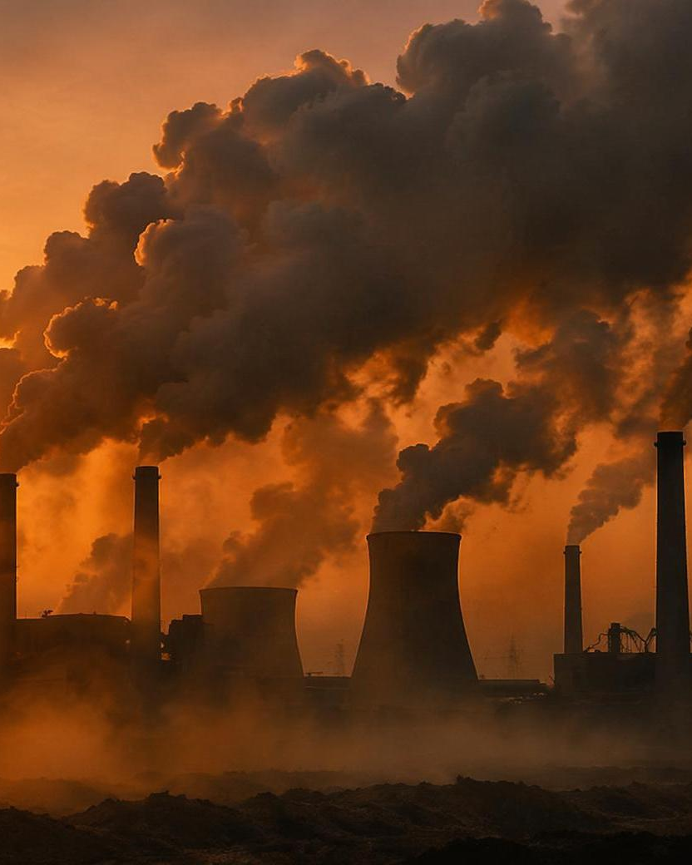
The Carbon Problem
38.1
billion tonnes of CO₂ from fossil fuels in 2025
A new record high
up 1.1% from the previous year
Main sources: coal, oil, and natural gas
Burning fossil fuels releases stored carbon
1.5°C carbon budget virtually exhausted
Only ~4 years of emissions remain at current rate
52% higher
than pre-industrial CO₂ levels
Notes:
Where is all this CO2 coming from? Fossil fuels — coal, oil, and natural gas.
In 2025, fossil fuel emissions hit a new record: 38.1 billion tonnes of CO2. That's up 1.1% from the year before. Despite growing awareness and renewable energy adoption, global emissions are still rising.
Here's the urgent part: scientists estimate that the remaining carbon budget to keep warming below 1.5°C is virtually exhausted. At current emission rates, we have roughly four years of emissions left before that budget is used up.
The good news is that 35 countries have managed to reduce emissions while still growing their economies — proving that decarbonization is possible. But the pace needs to accelerate dramatically.

Slide 6
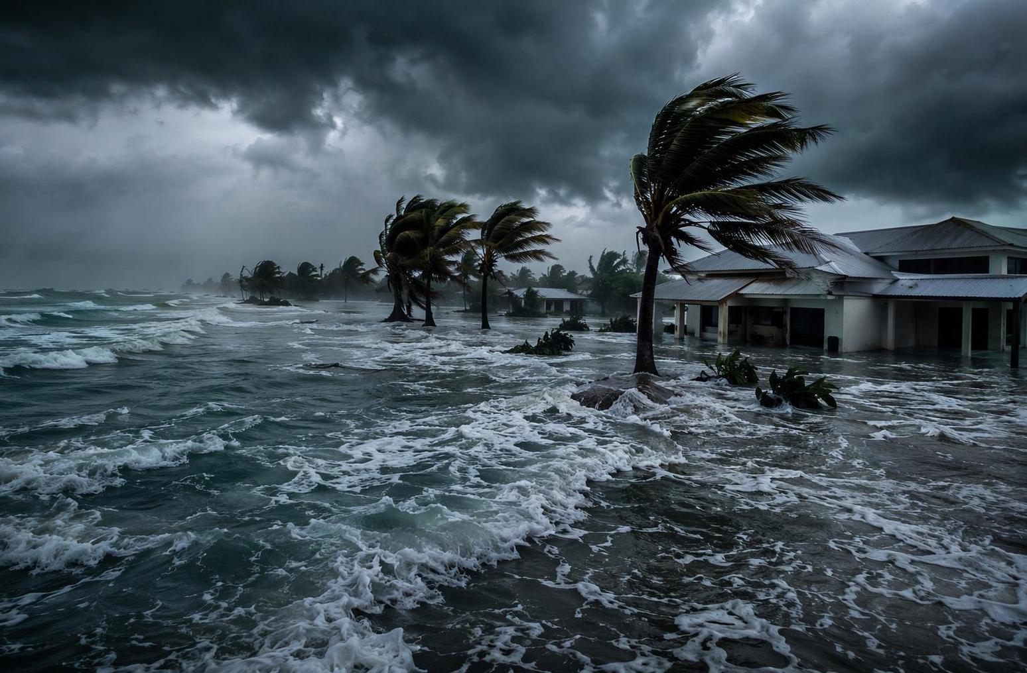
Rising Seas & Extreme Weather
3.7mm
per year
Sea level rise rate,
accelerating since 1993
18x
human energy use
Ocean heat absorbed
each year for 20 years
Record
low Arctic ice
Annual sea ice extent
at or near all-time low
Extreme events around the world caused disruption and devastation,
highlighting the vulnerability of interconnected economies and societies.
WMO State of the Global Climate 2025
Notes:
Climate change isn't something that might happen in the future — it's happening now, and its effects are all around us.
Sea levels are rising at about 3.7 millimeters per year, and that rate is accelerating. This threatens coastal communities worldwide — hundreds of millions of people live in areas vulnerable to flooding.
The ocean has been absorbing an enormous amount of heat — about 18 times more than all the energy humans use in a year, every year for the past two decades. 2025 set a new record for ocean heat content.
Arctic sea ice hit record or near-record lows, and glacier melt continued unabated. Meanwhile, extreme weather events — intense heat waves, heavy rainfall, devastating tropical cyclones — caused widespread disruption and highlighted how vulnerable our interconnected world really is.

Slide 7
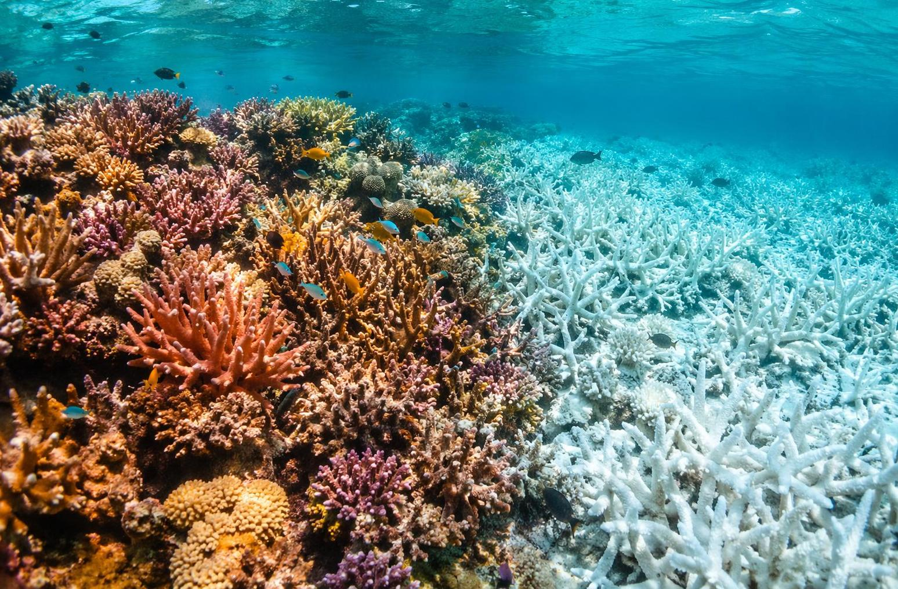
Biodiversity Under Threat
1 million
species face extinction
90%
coral reefs lost at 1.5°C
41%
of amphibians threatened
70%
of freshwater ecosystems degraded
Habitat loss, warming oceans, and shifting weather patterns are pushing species toward extinction faster than at any point since the age of dinosaurs.
Notes:
Climate change doesn't just affect weather and sea levels — it's reshaping the living world.
Around 1 million species currently face extinction, and the rate of species loss is accelerating faster than at any point since the dinosaurs disappeared 66 million years ago.
Coral reefs are especially vulnerable. At 1.5°C of warming, we could lose 90% of the world's coral reefs. At 2°C, virtually all of them. Reefs support about 25% of all marine species, so losing them would cascade through entire ocean ecosystems.
41% of amphibian species are threatened. 70% of freshwater ecosystems are degraded. 30% of marine species are at risk.
These aren't just numbers — every species lost weakens the web of life that we all depend on for food, clean water, and a stable climate.

Slide 8
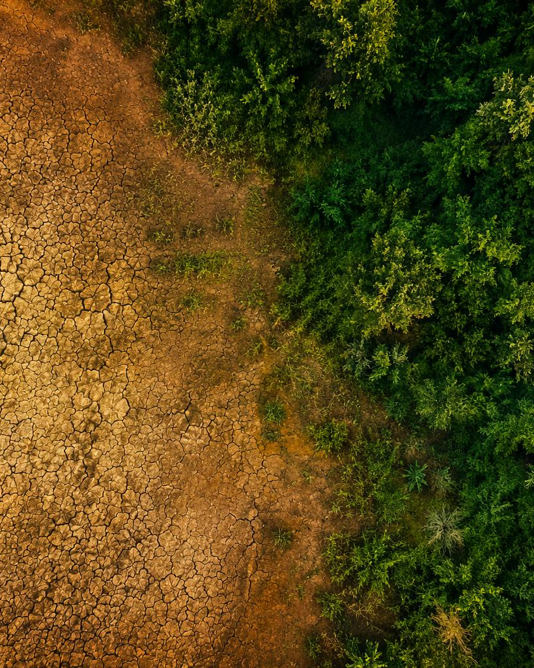
Earth's Carbon Cycle
The ocean absorbs over 90% of trapped heat
and about 25% of human CO₂ emissions each year
But sinks are weakening
Climate change has reduced land and ocean sinks by ~15% over the past decade
2025: Record ocean heat content
Oceans added 39x more heat than all annual human energy use
8% of atmospheric CO₂ rise since 1960
is due to climate change weakening natural sinks
Notes:
Earth has natural systems — called carbon sinks — that absorb CO2 from the atmosphere. The ocean and land ecosystems together absorb roughly half of our emissions each year.
But here's the concerning part: these sinks are weakening. Research published in Nature found that climate change has reduced the effectiveness of land and ocean sinks by about 15% over the past decade. Essentially, the hotter it gets, the less CO2 nature can absorb — creating a feedback loop.
In 2025, the oceans absorbed heat equivalent to 39 times total annual human energy use — a staggering figure. And 8% of the rise in atmospheric CO2 since 1960 can be attributed to climate change weakening these natural sinks.
This is why scientists say we can't rely on nature alone to solve the problem — we need to dramatically cut emissions at the source.

Slide 9
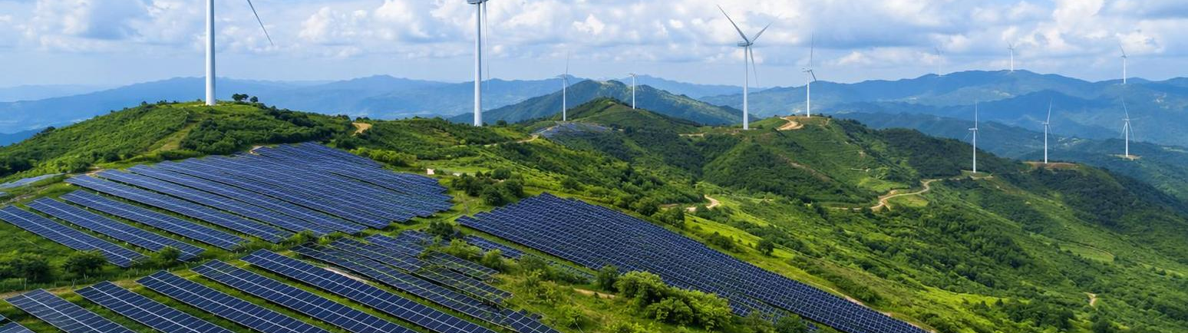
Solutions & Clean Energy
The path forward is clear — and progress is happening
35 Countries
Clean Energy
100+ Nations
have reduced emissions while growing their economies
Solar and wind capacity growing exponentially worldwide
committed to protecting 30% of land and ocean by 2030
Notes:
Now for some encouraging news. The solutions to climate change exist, and progress is real.
35 countries have successfully reduced their emissions while growing their economies — that's double the number from just a decade ago. This proves that economic growth and climate action aren't mutually exclusive.
Solar and wind energy capacity is growing exponentially. In many parts of the world, renewable energy is now cheaper than fossil fuels. The energy transition is happening — the question is whether it's happening fast enough.
Over 100 nations have committed to the 30x30 target — protecting 30% of the world's land and ocean by 2030. Conservation efforts like this help preserve the carbon sinks we just talked about.
Technology, policy, and international cooperation are all moving in the right direction. What we need is acceleration.

Slide 10
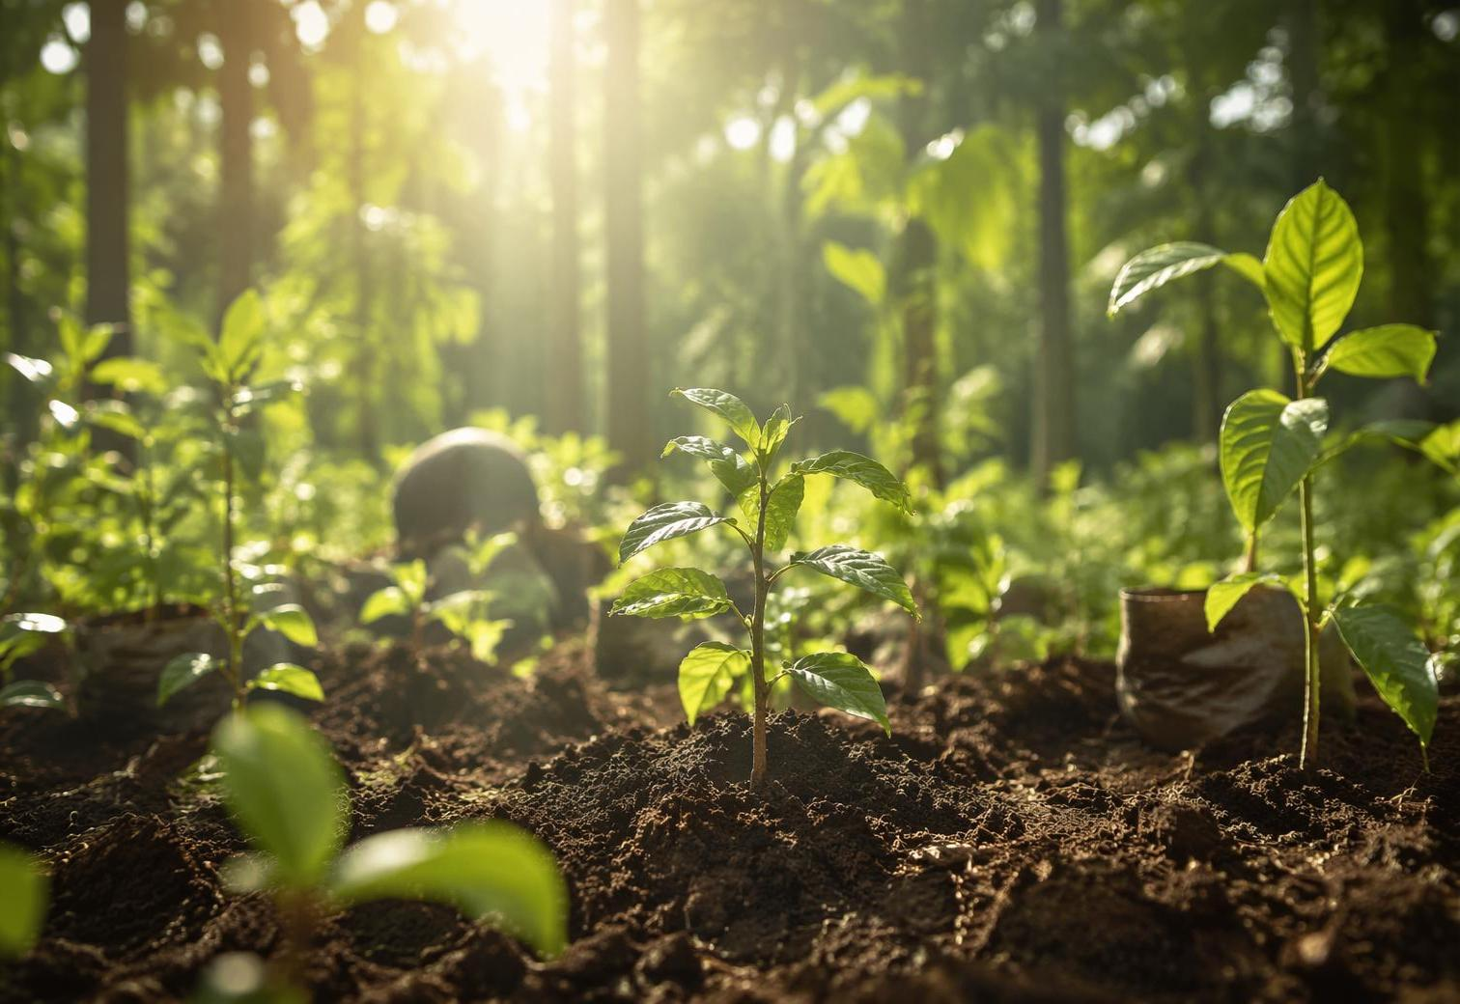
Your Generation, Your Future
Learn & Share
Understand the science — and help others understand it too
Reduce Your Footprint
Transportation, energy use, food choices — small changes add up
Speak Up
Advocate for climate policy, support clean energy, vote for the planet
Think Big
Pursue careers in science, engineering, and sustainability
The science is clear. The solutions exist. The time to act is now.
Notes:
So what can you do? More than you might think.
First, learn and share. You now understand the science — help others understand it too. Misinformation is one of the biggest barriers to climate action, and informed voices make a difference.
Second, reduce your footprint. Transportation choices, energy use at home, food decisions — especially reducing meat consumption — these individual actions add up when millions of people make them.
Third, speak up. Advocate for climate policy at your school, in your community, and through your vote. Young people have already shown they can drive political change on climate issues.
And finally, think big. The world needs scientists, engineers, policy makers, and entrepreneurs who are focused on sustainability. Your generation will build the clean energy systems, design the sustainable cities, and create the solutions we haven't even imagined yet.
The science is clear. The solutions exist. The time to act is now. Thank you.

